Slide 1
WiE WSF TSC WL Performance <SpecCpu-2017><Micro-Benchmark>
Kuang (Claire) Wu
xPSD – Workload Integration and Enabling (WiE) team
June 17, 2022

Slide 2
Agenda
Brief Introduction of SPEC CPU 2017
WL architecture, Test cases, KPI
System Configuration for Performance
Reference Comparison (WSA vs WSF)
Gen-To-Gen Comparison (ICX vs SPR) On-premise
Conclusion and Next Steps
2

Slide 3
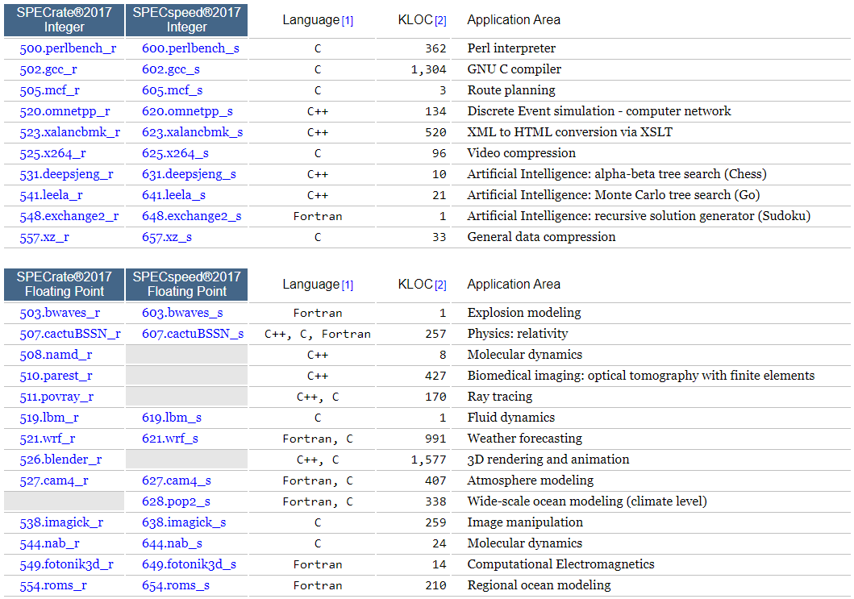
Brief introduction
SPEC CPU 2017 focuses on compute intensive performance, which means these benchmarks emphasize the performance of:
Processor - The CPU chip(s).
Memory - The memory hierarchy, including caches and main memory.
Compilers - C, C++, and Fortran compilers, including optimizers.
SPEC CPU 2017 has 43 benchmarks, organized into 4 suites:
SPECrate suites run multiple concurrent copies of each benchmark. Higher scores indicate more throughput (more work is done per unit of time).
SPECspeed suites always run one copy of each benchmark. Higher scores indicate that less time is needed.
3
Notes:
SPEC CPU 2017 intentionally depends on all three of the above - not just the processor.
Goals:
KPI compare with internal SPEC CPU 2017 team: cpu2017-1.1.5-ic2021.1-lin-core-avx512-20201113_revB int/fp rate/speed, with … percent variation
gen-to-gen ICX - SPR on-premise performance analysis
System requirements for the binaries:
glibc version 2.28+
OS: Red Hat 8, Cent OS 8, Ubuntu 20.04
32bit runtimes libgcc/libstdc++/glibc available
2 GB RAM per Rate copy or process launched
16.5 GB RAM for speed (tracked at 4 thread)
Physical storage: 250 GB. For Rate, add 1.2 GB per copy

Slide 4
Brief introduction
Test cases
test_speccpu_2017_v115_icc_intrate
test_speccpu_2017_v115_icc_fprate
test_speccpu_2017_v115_icc_intspeed
test_speccpu_2017_v115_icc_fpspeed
KPI
For SPECrate: throughput score
For SPECspeed: speed score
WL architecture
docker/k8s
SpecCpu2017 benchmarks
ICC_BINARIES: ic2021.1-lin-core-avx512-20201113_revB
SPEC2017_ISO_IMAGE: 1.1.5
debian:11
WSF integrated SPEC CPU 2017 versions | 1.1.0, 1.1.5, 1.1.8
WSF Supported Platforms | ICX, SPR, GNR, MILAN, ROME, GRAVITON2, GRAVITON3
Host OS
Platform: ICX, SPR
4
Notes:
Binary: cpu2017-1.1.5-ic2021.1-lin-core-avx512-20201113_revB
1) This is Intel recommended binaries package for best performance.
2) The binaries on this package are compiled on RHEL8.
KPI: For both SPECspeed and SPECrate, the selected ratios are averaged using the Geometric Mean, which is reported as the overall metric.

Slide 5
System Configuration
BIOS settings | Recommended values
Hyper-Threading | Enabled
CPU Power and Performance Policy | Performance
Intel Turbo Boost Technology | Enabled
Energy Efficient Turbo | Disabled
DCU Streamer Prefetcher | Disabled
SNC (Sub NUMA) | Disabled
Stale AtoS | Enabled
LLC Dead Line Alloc | Disabled
5
Notes:
Set for best performance
SNC?

Slide 6
System Configuration
Name | ICX110 | SPR97623
Time | Mon Jun 6 09:00:08 AM UTC 2022 | Mon Jun 6 09:26:47 UTC 2022
Manufacturer | Intel Corporation | Intel Corporation
Product Name | M50CYP2SBSTD | ArcherCity
BIOS Version | SE5C620.86B.01.01.0003.2104260124 | EGSDCRB1.86B.0078.D27.2204181335
OS | Ubuntu 22.04 LTS | CentOS Stream 8
Kernel | 5.15.0-25-generic | 5.15.0-spr.bkc.pc.5.12.0.x86_64
Microcode | 0xd0002a0 | 0x8e0002a0
IRQ Balance | Enabled | Enabled
CPU Model | Intel(R) Xeon(R) Platinum 8358 CPU @ 2.60GHz | Genuine Intel(R) CPU 0000%@ - Q03J
Base Frequency | 2.6GHz | 1.6GHz
Maximum Frequency | 3.4GHz | 3.5GHz
All-core Maximum Frequency | 3.3GHz | 2.6GHz
CPU(s) | 128 | 240
Thread(s) per Core | 2 | 2
Core(s) per Socket | 32 | 60
Socket(s) | 2 | 2
NUMA Node(s) | 2 | 2
L3 Cache | 96 MiB (2 instances) | 115200K
Prefetchers | DCU IP, L2 HW, L2 Adj. | DCU IP, L2 HW, L2 Adj.
Turbo | Enabled | Enabled
PPIN(s) | Not Found | 5df94908a5e86db4
Power & Perf Policy | Performance | Performance
TDP | 250 watts | 350 watts
Frequency Driver | intel_pstate | intel_pstate
Frequency Governer | performance | performance
Frequency (MHz) | Not Found | 1600
Max C-State | 9 | 9
Installed Memory | 512GB (16x32GB DDR4 3200MT/s [3200MT/s]) | 512GB (16x32GB DDR5 4800MT/s [4800MT/s])
Huge Pages Size | 1048576 kB | 1048576 kB
Transparent Huge Pages | madvise | always
Automatic NUMA Balancing | Enabled | Enabled
6

Slide 7
Reference Comparison (WSA vs WSF) intrate
WSA system: 2 sockets, SPR Q03K - E stepping, 56 cores / 112 threads, Cache: 105 MB, All Core Turbo Freq: 2.8 GHz, 512 GB memory
WSF system: 2 sockets, SPR Q03J - E stepping, 60 cores / 120 threads, Cache: 112.5 MB, All Core Turbo Freq: 2.6 GHz, 512 GB memory
Benchmark | WSA | WSF | WSA/core/GHz | WSF/core/GHz | WSF/WSA per core per GHz
500.perlbench_r | 587.3 | 614.6 | 0.9364 | 0.9849 | 1.05
502.gcc_r | 605.8 | 636.2 | 0.9659 | 1.0195 | 1.06
505.mcf_r | 1160.4 | 1240.6 | 1.8501 | 1.9881 | 1.07
520.omnetpp_r | 472.3 | 502.2 | 0.7530 | 0.8048 | 1.07
523.xalancbmk_r | 1044.2 | 1094.5 | 1.6649 | 1.7540 | 1.05
525.x264_r | 1572.0 | 1649.5 | 2.5064 | 2.6435 | 1.05
531.deepsjeng_r | 612.2 | 631.5 | 0.9761 | 1.0121 | 1.04
541.leela_r | 594.6 | 619.4 | 0.9480 | 0.9926 | 1.05
548.exchange2_r | 1478.9 | 1527.3 | 2.3579 | 2.4476 | 1.04
557.xz_r | 400.0 | 417.3 | 0.6378 | 0.6687 | 1.05
SPECrate2017_int_base | 765.3 | 801.7 | 1.2202 | 1.2847 | 1.05
WSA and WSF use the same binaries cpu2017-1.1.5-ic2021.1-lin-core-avx512-20201113_revB.
After roughly normalized with the number of cores and all core turbo frequency, WSF is within 5% WSA on overall throughput.
WSA: Workload, Standards and Automation in IPCA / DEG group
7
Notes:
Prasad: I am part of the team call Workload, Standards and Automation (WSA) in IPCA / DEG group. Our team works on development of industry standard benchmarks - one of them being SPEC CPU. I am one of 2 Intel reps on SPEC CPU committee. Besides SPEC CPU development duties, I own all SPEC CPU 2017 binaries being used within Intel. I also provide Intel optimized binaries to Intel OEMs for their measurements.
Prasad OS: CentOS Linux 8.4

Slide 8
Reference Comparison (WSA vs WSF) fprate
WSA system: 2 sockets, SPR Q03K - E stepping, 56 cores / 112 threads, Cache: 105 MB, All Core Turbo Freq: 2.8 GHz, 512 GB memory
WSF system: 2 sockets, SPR Q03J - E stepping, 60 cores / 120 threads, Cache: 112.5 MB, All Core Turbo Freq: 2.6 GHz, 512 GB memory
Benchmark | WSA | WSF | WSA/core/GHz | WSF/core/GHz | WSF/WSA per core per GHz
503.bwaves_r | 1069.7 | 1094.4 | 1.7055 | 1.7538 | 1.03
507.cactuBSSN_r | 949.8 | 970.5 | 1.5143 | 1.5553 | 1.03
508.namd_r | 648.4 | 686.6 | 1.0338 | 1.1004 | 1.06
510.parest_r | 364.5 | 370.4 | 0.5812 | 0.5936 | 1.02
511.povray_r | 922 | 1015.6 | 1.4700 | 1.6275 | 1.11
519.lbm_r | 363.6 | 372.9 | 0.5797 | 0.5975 | 1.03
521.wrf_r | 537.8 | 557.3 | 0.8575 | 0.8930 | 1.04
526.blender_r | 776.5 | 801.6 | 1.2380 | 1.2846 | 1.04
527.cam4_r | 821.7 | 853.2 | 1.3101 | 1.3673 | 1.04
538.imagick_r | 2209.4 | 2399.4 | 3.5226 | 3.8452 | 1.09
544.nab_r | 1322.2 | 1407.6 | 2.1081 | 2.2557 | 1.07
549.fotonik3d_r | 343.3 | 355.2 | 0.5474 | 0.5692 | 1.04
554.roms_r | 267.7 | 280.3 | 0.4268 | 0.4492 | 1.05
SPECrate2017_fp_base | 685.7 | 716.5 | 1.0933 | 1.1482 | 1.05
WSA and WSF use the same binaries cpu2017-1.1.5-ic2021.1-lin-core-avx512-20201113_revB.
After roughly normalized with the number of cores and all core turbo frequency, WSF is within 5% WSA on overall throughput.
WSA: Workload, Standards and Automation in IPCA / DEG group
8
Notes:
Prasad: I am part of the team call Workload, Standards and Automation (WSA) in IPCA / DEG group. Our team works on development of industry standard benchmarks - one of them being SPEC CPU. I am one of 2 Intel reps on SPEC CPU committee. Besides SPEC CPU development duties, I own all SPEC CPU 2017 binaries being used within Intel. I also provide Intel optimized binaries to Intel OEMs for their measurements.
Prasad OS: CentOS Linux 8.4

Slide 9
Gen-to-Gen Comparison (ICX vs SPR) intrate
ICX
numactl --interleave=all runcpu --define numcopies=128 -c ic2021.1-lin-core-avx512-rate-20201113_revB.cfg -n 1 --noreportable --nobuild --action validate --define default-platform-flags --define cores=128 --define physicalfirst --tune base --size ref -o all --define drop_caches --output_format=all -I --define invoke_with_interleave -I intrate
SPR
numactl --interleave=all runcpu --define numcopies=240 -c ic2021.1-lin-core-avx512-rate-20201113_revB.cfg -n 1 --noreportable --nobuild --action validate --define default-platform-flags --define cores=240 --define physicalfirst --tune base --size ref -o all --define drop_caches --output_format=all -I --define invoke_with_interleave -I intrate
Benchmark | ICX | SPR | ICX op freq (GHz) | SPR op freq (GHz) | ICX/core/GHz | SPR/core/GHz | SPR/ICX per core per GHz
500.perlbench_r | 303.42 | 614.59 | 2.9657 | 2.4554 | 0.7993 | 1.0429 | 1.30
502.gcc_r | 335.09 | 636.18 | 3.0611 | 2.5137 | 0.8552 | 1.0545 | 1.23
505.mcf_r | 709.00 | 1240.60 | 2.8360 | 2.3117 | 1.9531 | 2.2361 | 1.14
520.omnetpp_r | 257.81 | 502.19 | 3.1033 | 2.5925 | 0.6490 | 0.8071 | 1.24
523.xalancbmk_r | 537.49 | 1094.53 | 2.8681 | 2.4586 | 1.4641 | 1.8549 | 1.27
525.x264_r | 906.79 | 1649.52 | 2.8179 | 2.5496 | 2.5141 | 2.6958 | 1.07
531.deepsjeng_r | 354.01 | 631.54 | 3.0229 | 2.5724 | 0.9149 | 1.0229 | 1.12
541.leela_r | 356.37 | 619.37 | 3.0624 | 2.5785 | 0.9091 | 1.0009 | 1.10
548.exchange2_r | 951.28 | 1527.29 | 2.9995 | 2.5788 | 2.4777 | 2.4677 | 1.00
557.xz_r | 231.50 | 417.28 | 3.1755 | 2.5555 | 0.5695 | 0.6804 | 1.19
SPECrate2017_int_base | 436.60 | 801.67 | 2.9891 | 2.5153 | 1.1411 | 1.3280 | 1.16
After normalized with the number of cores and the operating frequency, SPR is 16% better than ICX on the overall throughput.
9
Notes:
For the SPECrate metrics, multiple copies of the benchmarks are run simultaneously. Typically, the number of copies is the same as the number of CPUs on the machine.
The numactl mechanism was used to bind copies to processors. The config file option 'submit’ was used to generate numactl commands to bind each copy to a specific processor.
numactl --localalloc --physcpubind=$SPECCOPYNUM
Physical logical cores
Environment variables set by runcpu before the start of the run:
LD_LIBRARY_PATH ="/opt/spec2017/lib/intel64:/opt/spec2017/lib/ia32:/opt/spec2017/je5.0.1-32"
MALLOC_CONF = "retain:true"

Slide 10
EMON data intrate
500.perlbench_r SPR/ICX per core per GHz = 1.30
EDP 4.31 | ICX | SPR
metric_CPU operating frequency (in GHz) | 2.99 | 2.47
metric_CPU utilization % | 100.02 | 100.02
metric_CPU utilization% in kernel mode | 0.38 | 1.06
metric_CPI | 0.67 | 0.50
metric_kernel_CPI | 3.86 | 4.12
metric_TMA_Metrics_Version | 4.30 | 4.30
metric_TMA_Frontend_Bound(%) | 23.18 | 23.27
metric_TMA_..Fetch_Latency(%) | 14.12 | 9.07
metric_TMA_..Fetch_Bandwidth(%) | 9.07 | 14.20
metric_TMA_Bad_Speculation(%) | 4.55 | 9.48
metric_TMA_..Branch_Mispredicts(%) | 4.52 | 8.90
metric_TMA_..Machine_Clears(%) | 0.03 | 0.58
metric_TMA_Backend_Bound(%) | 16.90 | 5.09
metric_TMA_..Memory_Bound(%) | 8.02 | 3.09
metric_TMA_..Core_Bound(%) | 8.88 | 1.99
metric_TMA_Retiring(%) | 55.37 | 62.16
metric_TMA_..Light_Operations(%) | 53.76 | 58.46
metric_TMA_..Heavy_Operations(%) | 1.61 | 3.71
548.exchange2_r SPR/ICX per core per GHz = 1.00
EDP 4.31 | ICX | SPR
metric_CPU operating frequency (in GHz) | 2.99 | 2.58
metric_CPU utilization % | 100.00 | 100.00
metric_CPU utilization% in kernel mode | 0.22 | 0.78
metric_CPI | 0.92 | 0.92
metric_kernel_CPI | 2.72 | 3.33
metric_TMA_Metrics_Version | 4.30 | 4.30
metric_TMA_Frontend_Bound(%) | 28.95 | 40.68
metric_TMA_..Fetch_Latency(%) | 11.44 | 13.84
metric_TMA_..Fetch_Bandwidth(%) | 17.50 | 26.84
metric_TMA_Bad_Speculation(%) | 7.71 | 10.05
metric_TMA_..Branch_Mispredicts(%) | 7.68 | 9.36
metric_TMA_..Machine_Clears(%) | 0.02 | 0.69
metric_TMA_Backend_Bound(%) | 7.79 | 2.84
metric_TMA_..Memory_Bound(%) | 2.42 | 0.99
metric_TMA_..Core_Bound(%) | 5.37 | 1.85
metric_TMA_Retiring(%) | 55.55 | 46.43
metric_TMA_..Light_Operations(%) | 38.55 | 31.97
metric_TMA_..Heavy_Operations(%) | 17.00 | 14.45

Slide 11
Gen-to-Gen Comparison (ICX vs SPR) intspeed
ICX
KMP_AFFINITY = "granularity=fine,scatter“
numactl --interleave=all runcpu --define numcopies=1 --define intspeedaffinity -c ic2021.1-lin-core-avx512-speed-20201113_revB.cfg -n 1 --noreportable --nobuild --action validate --define default-platform-flags --define cores=128 --define physicalfirst --tune base --size ref -o all --define drop_caches --output_format=all -I --define invoke_with_interleave -I intspeed
SPR
KMP_AFFINITY = "granularity=fine,scatter"
numactl --interleave=all runcpu --define numcopies=1 --define intspeedaffinity -c ic2021.1-lin-core-avx512-speed-20201113_revB.cfg -n 1 --noreportable --nobuild --action validate --define default-platform-flags --define cores=240 --define physicalfirst --tune base --size ref -o all --define drop_caches --output_format=all -I --define invoke_with_interleave -I intspeed
Benchmark | ICX | SPR | SPR/ICX | ICX op freq (GHz) | SPR op freq (GHz) | SPR/ICX per GHz
600.perlbench_s | 6.63 | 6.21 | 0.94 | 3.3 | 2.6 | 1.19
602.gcc_s | 9.34 | 8.06 | 0.86 | 3.3 | 2.6 | 1.10
605.mcf_s | 16.50 | 14.70 | 0.89 | 3.3 | 2.6 | 1.13
620.omnetpp_s | 11.06 | 9.36 | 0.85 | 3.3 | 2.6 | 1.07
623.xalancbmk_s | 12.66 | 11.56 | 0.91 | 3.3 | 2.6 | 1.16
625.x264_s | 15.78 | 14.79 | 0.94 | 3.3 | 2.6 | 1.19
631.deepsjeng_s | 5.40 | 4.58 | 0.85 | 3.3 | 2.6 | 1.08
641.leela_s | 4.58 | 3.85 | 0.84 | 3.3 | 2.6 | 1.07
648.exchange2_s | 18.28 | 14.17 | 0.78 | 3.3 | 2.6 | 0.98
657.xz_s | 20.17 | 17.88 | 0.89 | 3.3 | 2.6 | 1.13
SPECspeed2017_int_base | 10.75 | 9.38 | 0.87 | 3.3 | 2.6 | 1.11
After normalized with the operating frequency, SPR is 11% better than ICX on the overall speed.
With exception of 648.exchange2_s, SPR is better than ICX on individual benchmark.
Observations:
Every benchmark in intspeed suite except 657.xz_s runs on 1 core 1 thread, and migrates among cores during execution.
By design, 657.xz_s is a multi-core multi-thread benchmark.
11
Notes:
Multi-threading -- 657
Environment variables set by runcpu before the start of the run:
KMP_AFFINITY = "granularity=fine,scatter“
LD_LIBRARY_PATH = "/opt/spec2017/lib/intel64:/opt/spec2017/je5.0.1-64“
MALLOC_CONF = "retain:true“
OMP_STACKSIZE = "192M"

Slide 12
Gen-to-Gen Comparison (ICX vs SPR) fprate
ICX
numactl --interleave=all runcpu --define numcopies=128 -c ic2021.1-lin-core-avx512-rate-20201113_revB.cfg -n 1 --noreportable --nobuild --action validate --define default-platform-flags --define cores=128 --define physicalfirst --tune base --size ref -o all --define drop_caches --output_format=all -I --define invoke_with_interleave -I fprate
SPR
numactl --interleave=all runcpu --define numcopies=240 -c ic2021.1-lin-core-avx512-rate-20201113_revB.cfg -n 1 --noreportable --nobuild --action validate --define default-platform-flags --define cores=240 --define physicalfirst --tune base --size ref -o all --define drop_caches --output_format=all -I --define invoke_with_interleave -I fprate
Benchmark | ICX | SPR | ICX op freq (GHz) | SPR op freq (GHz) | ICX/core/GHz | SPR/core/GHz | SPR/ICX per core per GHz
503.bwaves_r | 714.98 | 1094.38 | 3.2599 | 2.5998 | 1.7135 | 1.7539 | 1.02
507.cactuBSSN_r | 560.51 | 970.53 | 2.6880 | 2.2515 | 1.6291 | 1.7961 | 1.10
508.namd_r | 340.03 | 686.63 | 2.8629 | 2.4451 | 0.9279 | 1.1701 | 1.26
510.parest_r | 199.57 | 370.38 | 3.1188 | 2.4350 | 0.4999 | 0.6338 | 1.27
511.povray_r | 492.00 | 1015.56 | 2.7673 | 2.2500 | 1.3890 | 1.8807 | 1.35
519.lbm_r | 260.32 | 372.87 | 2.8573 | 2.5409 | 0.7118 | 0.6114 | 0.86
521.wrf_r | 338.47 | 557.26 | 3.0263 | 2.5421 | 0.8738 | 0.9134 | 1.05
526.blender_r | 432.43 | 801.61 | 2.9907 | 2.4015 | 1.1296 | 1.3908 | 1.23
527.cam4_r | 444.64 | 853.22 | 2.7216 | 2.0601 | 1.2764 | 1.7257 | 1.35
538.imagick_r | 1150.85 | 2399.39 | 2.9524 | 2.5022 | 3.0453 | 3.9954 | 1.31
544.nab_r | 753.36 | 1407.58 | 2.7818 | 2.3852 | 2.1157 | 2.4588 | 1.16
549.fotonik3d_r | 225.96 | 355.16 | 3.3000 | 2.5997 | 0.5350 | 0.5692 | 1.06
554.roms_r | 156.13 | 280.28 | 3.1478 | 2.5596 | 0.3875 | 0.4563 | 1.18
SPECrate2017_fp_base | 401.00 | 716.46 | 2.9533 | 2.4235 | 1.0608 | 1.2318 | 1.16
After normalized with the number of cores and the operating frequency, SPR is 16% better than ICX on the overall throughput.
12
Notes:
Environment variables set by runcpu before the start of the run:
LD_LIBRARY_PATH = "/opt/spec2017/lib/intel64:/opt/spec2017/je5.0.1-64“
MALLOC_CONF = "retain:true"

Slide 13
EMON data fprate
511.povray_r SPR/ICX per core per GHz = 1.35
EDP 4.31 | ICX | SPR
metric_CPU operating frequency (in GHz) | 2.70 | 2.26
metric_CPU utilization % | 100.01 | 100.00
metric_CPU utilization% in kernel mode | 0.25 | 1.08
metric_CPI | 0.69 | 0.51
metric_kernel_CPI | 2.51 | 4.10
metric_TMA_Metrics_Version | 4.30 | 4.30
metric_TMA_Frontend_Bound(%) | 23.80 | 20.17
metric_TMA_..Fetch_Latency(%) | 15.58 | 8.54
metric_TMA_..Fetch_Bandwidth(%) | 8.23 | 11.63
metric_TMA_Bad_Speculation(%) | 1.40 | 7.79
metric_TMA_..Branch_Mispredicts(%) | 1.37 | 6.42
metric_TMA_..Machine_Clears(%) | 0.03 | 1.37
metric_TMA_Backend_Bound(%) | 14.15 | 4.07
metric_TMA_..Memory_Bound(%) | 4.32 | 1.41
metric_TMA_..Core_Bound(%) | 9.83 | 2.66
metric_TMA_Retiring(%) | 60.65 | 67.97
metric_TMA_..Light_Operations(%) | 54.94 | 60.42
metric_TMA_..Heavy_Operations(%) | 5.70 | 7.55
519.lbm_r SPR/ICX per core per GHz = 0.86
EDP 4.31 | ICX | SPR
metric_CPU operating frequency (in GHz) | 2.77 | 2.53
metric_CPU utilization % | 100.03 | 100.04
metric_CPU utilization% in kernel mode | 1.58 | 0.87
metric_CPI | 2.30 | 2.76
metric_kernel_CPI | 5.67 | 3.72
metric_TMA_Metrics_Version | 4.30 | 4.30
metric_TMA_Frontend_Bound(%) | 4.08 | 3.67
metric_TMA_..Fetch_Latency(%) | 3.69 | 3.23
metric_TMA_..Fetch_Bandwidth(%) | 0.38 | 0.45
metric_TMA_Bad_Speculation(%) | 0.53 | 0.62
metric_TMA_..Branch_Mispredicts(%) | 0.40 | 0.01
metric_TMA_..Machine_Clears(%) | 0.13 | 0.61
metric_TMA_Backend_Bound(%) | 78.81 | 83.87
metric_TMA_..Memory_Bound(%) | 62.23 | 77.67
metric_TMA_..Core_Bound(%) | 16.58 | 6.20
metric_TMA_Retiring(%) | 16.58 | 11.83
metric_TMA_..Light_Operations(%) | 15.96 | 11.81
metric_TMA_..Heavy_Operations(%) | 0.62 | 0.02

Slide 14
Gen-to-Gen Comparison (ICX vs SPR) fpspeed
ICX
KMP_AFFINITY = "granularity=fine,compact"
numactl --interleave=all runcpu --define numcopies=1 -c ic2021.1-lin-core-avx512-speed-20201113_revB.cfg -n 1 --noreportable --nobuild --action validate --define default-platform-flags --define cores=128 --define physicalfirst --tune base --size ref -o all --define drop_caches --output_format=all -I --define invoke_with_interleave -I fpspeed
SPR
KMP_AFFINITY = "granularity=fine,compact"
numactl --interleave=all runcpu --define numcopies=1 -c ic2021.1-lin-core-avx512-speed-20201113_revB.cfg -n 1 --noreportable --nobuild --action validate --define default-platform-flags --define cores=240 --define physicalfirst --tune base --size ref -o all --define drop_caches --output_format=all -I --define invoke_with_interleave -I fpspeed
Benchmark | ICX | SPR | SPR/ICX | ICX op freq (GHz) | SPR op freq (GHz) | SPR/ICX per GHz
603.bwaves_s | 451.93 | 629.97 | 1.39 | 3.3 | 2.6 | 1.77
607.cactuBSSN_s | 196.00 | 254.20 | 1.30 | 3.3 | 2.6 | 1.65
619.lbm_s | 87.70 | 127.19 | 1.45 | 3.3 | 2.6 | 1.84
621.wrf_s | 146.97 | 151.47 | 1.03 | 3.3 | 2.6 | 1.31
627.cam4_s | 133.14 | 174.15 | 1.31 | 3.3 | 2.6 | 1.66
628.pop2_s | 66.89 | 57.31 | 0.86 | 3.3 | 2.6 | 1.09
638.imagick_s | 175.43 | 245.79 | 1.40 | 3.3 | 2.6 | 1.78
644.nab_s | 421.19 | 590.52 | 1.40 | 3.3 | 2.6 | 1.78
649.fotonik3d_s | 81.09 | 109.14 | 1.35 | 3.3 | 2.6 | 1.71
654.roms_s | 159.00 | 365.51 | 2.30 | 3.3 | 2.6 | 2.92
SPECspeed2017_fp_base | 157.98 | 211.40 | 1.34 | 3.3 | 2.6 | 1.70
After normalized with the operating frequency, SPR is 70% better than ICX on the overall speed.
Observation:
Every benchmark in fpspeed suite runs 1 copy of the benchmark parallelly over all cores.
14
Notes:
a speed run which uses a parallelizing compiler to distribute one copy of a benchmark over multiple CPUs is still a speed run, and uses the SPECspeed metrics. The tester may choose how many OpenMP threads to use.
/s -- per Hz
All cores utilized
Environment variables set by runcpu before the start of the run:
KMP_AFFINITY = "granularity=fine,compact“
LD_LIBRARY_PATH = "/opt/spec2017/lib/intel64:/opt/spec2017/je5.0.1-64"
MALLOC_CONF = "retain:true“
OMP_STACKSIZE = "192M"

Slide 15
Conclusion & Next Steps
Performance Results
After roughly normalized with the number of cores and all core turbo frequency, WSF is on par with WSA.
After normalized with the number of cores and the operating frequency, SPR is 16% better than ICX on the overall throughput in SPECrate.
After normalized with the operating frequency, SPR is 11%/70% better than ICX on the overall speed in intspeed/fpspeed suite respectively.
Performance Analysis
519.lbm_r is memory bounded.
Next Steps:
Gen-To-Gen Comparison (ICX vs SPR) On-premise Continue:
Performance analysis (TMA) on the rest of benchmarks
Address opens in previous observations
Gcc vs icc on ICX/SPR
SNC enabled results
Cloud (ICX/AMD/ARM)
15

Slide 16

Photo Example On Lower Half
Thank You
16

Slide 17
BACK UP

Slide 18
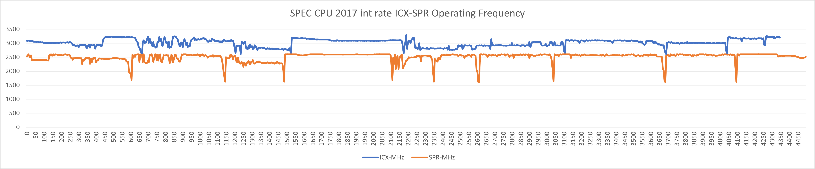
Gen-to-Gen Comparison (ICX vs SPR) intrate
18
Notes:
notes: no numa//numa=0 from SF code

Slide 19
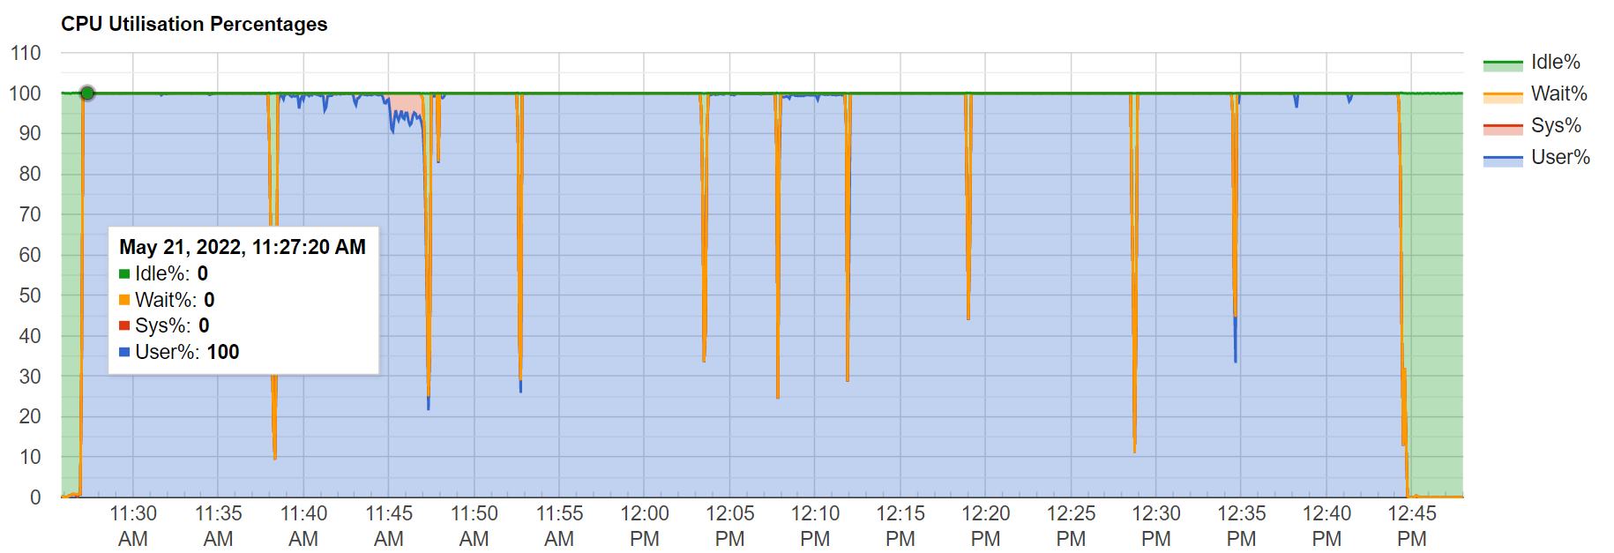
Gen-to-Gen Comparison (ICX vs SPR) intrate
ICX CPU utilization
19
Notes:
Add 10 benchmarks cpu utilization 100%, P14 15 together

Slide 20
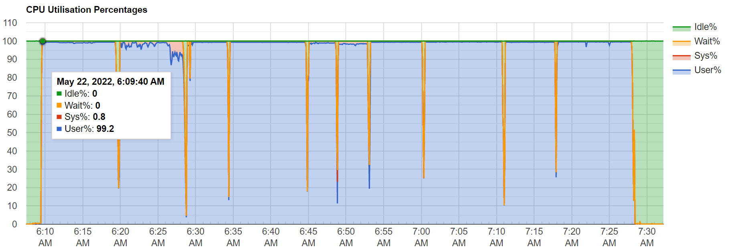
Gen-to-Gen Comparison (ICX vs SPR) intrate
SPR CPU utilization
20

Slide 21
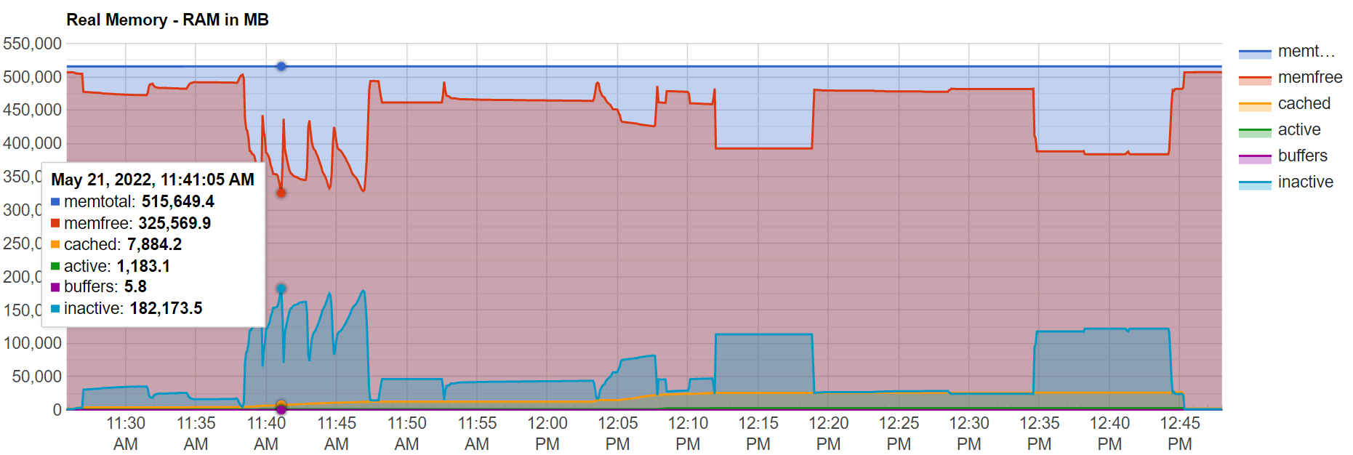
Gen-to-Gen Comparison (ICX vs SPR) intrate
ICX Memory utilization
21
Notes:
Add 1 line of description: No memory bound reached

Slide 22
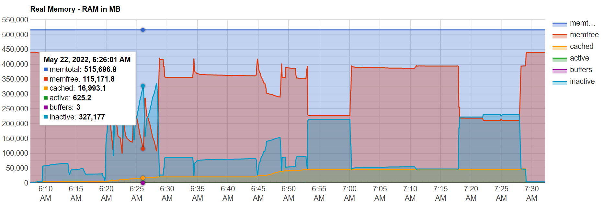
Gen-to-Gen Comparison (ICX vs SPR) intrate
SPR Memory utilization
22
Notes:
Add 1 line of description: 2 GB RAM per Rate copy or process launched

Slide 23
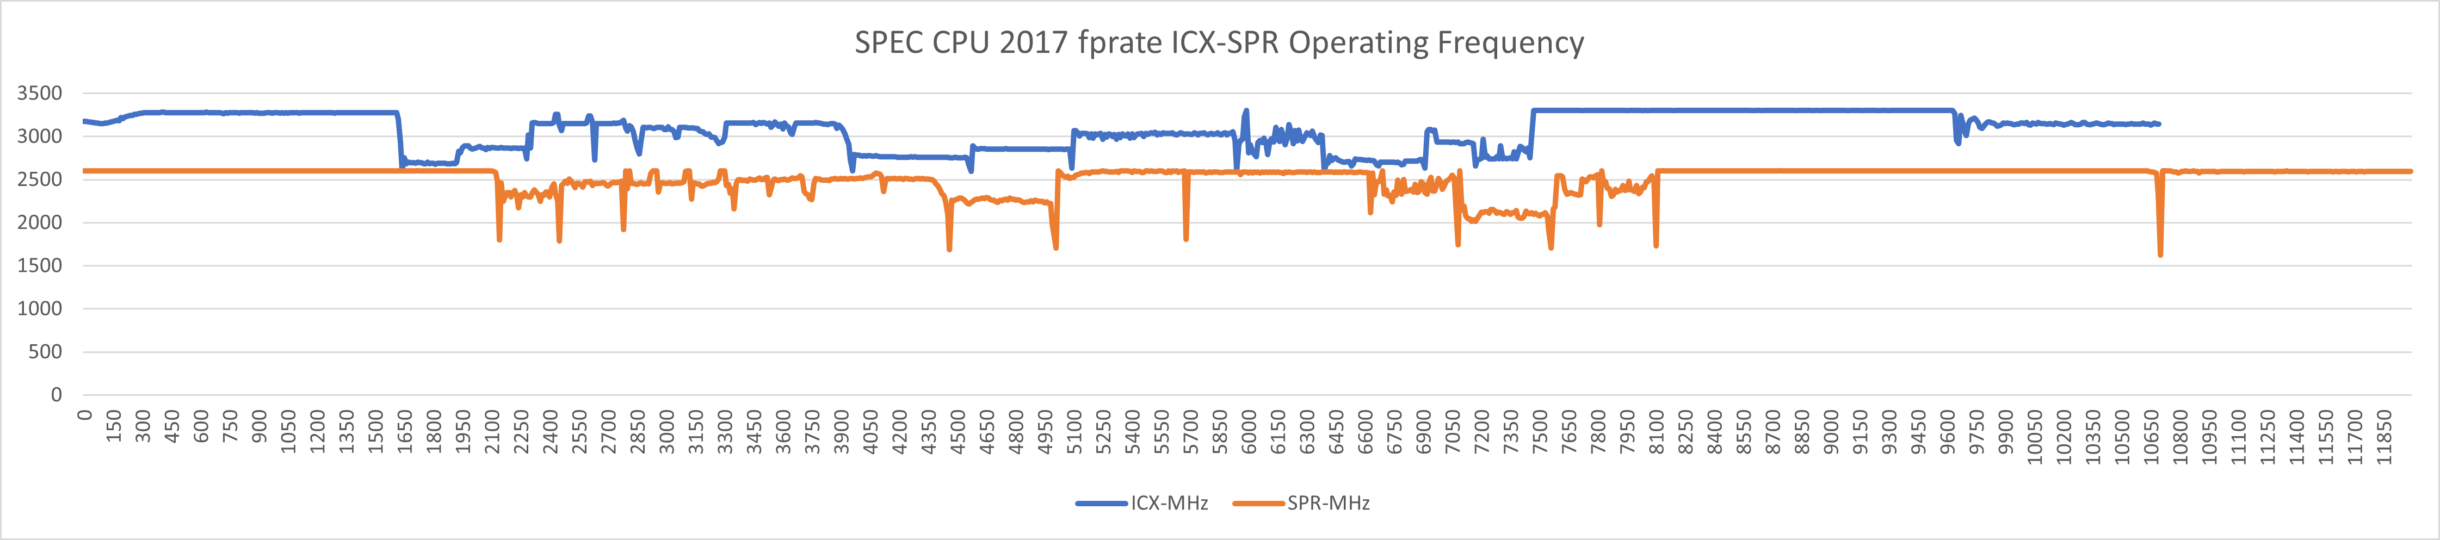
Gen-to-Gen Comparison (ICX vs SPR) fprate
23

Slide 24
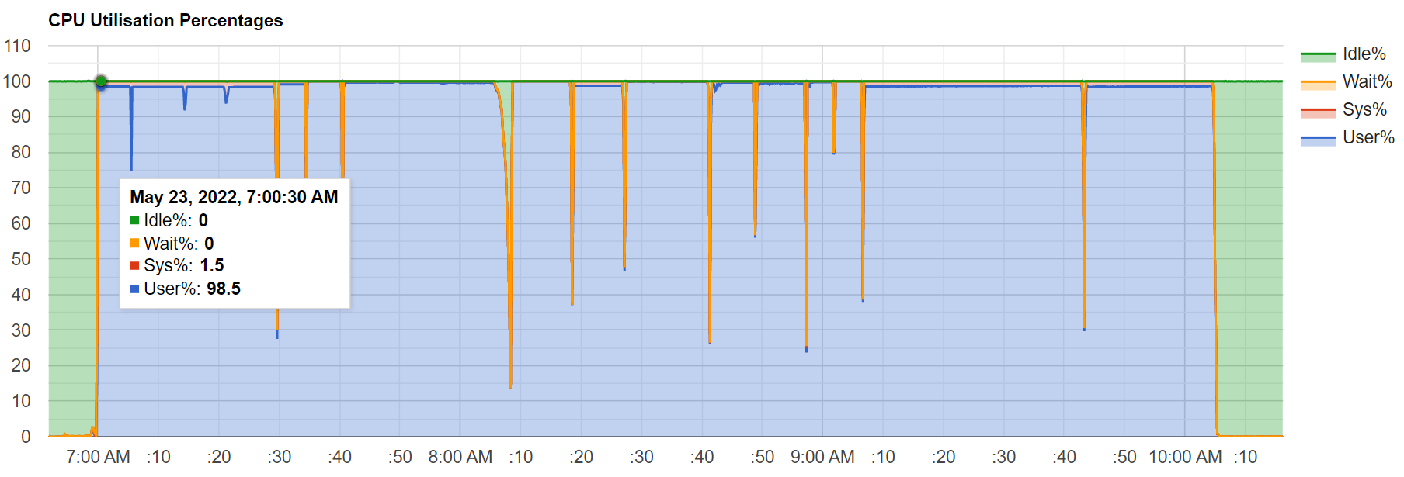
Gen-to-Gen Comparison (ICX vs SPR) fprate
ICX CPU utilization
24

Slide 25
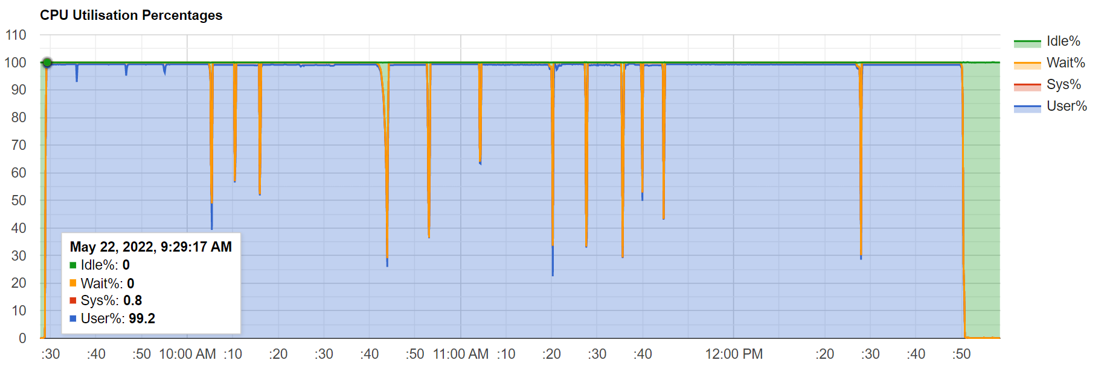
Gen-to-Gen Comparison (ICX vs SPR) fprate
SPR CPU utilization
25

Slide 26
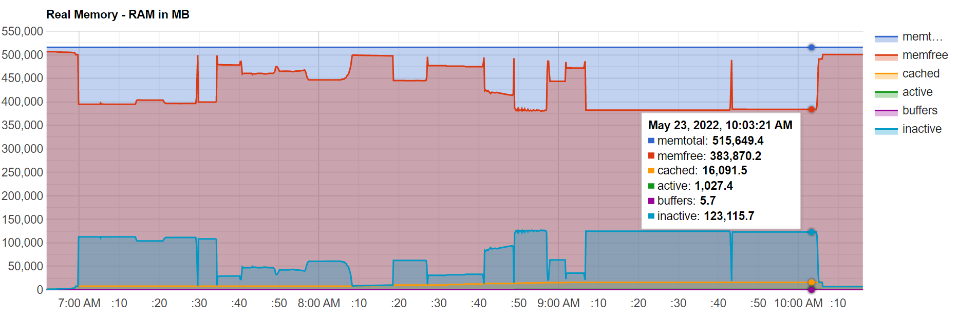
Gen-to-Gen Comparison (ICX vs SPR) fprate
ICX Memory utilization
26

Slide 27
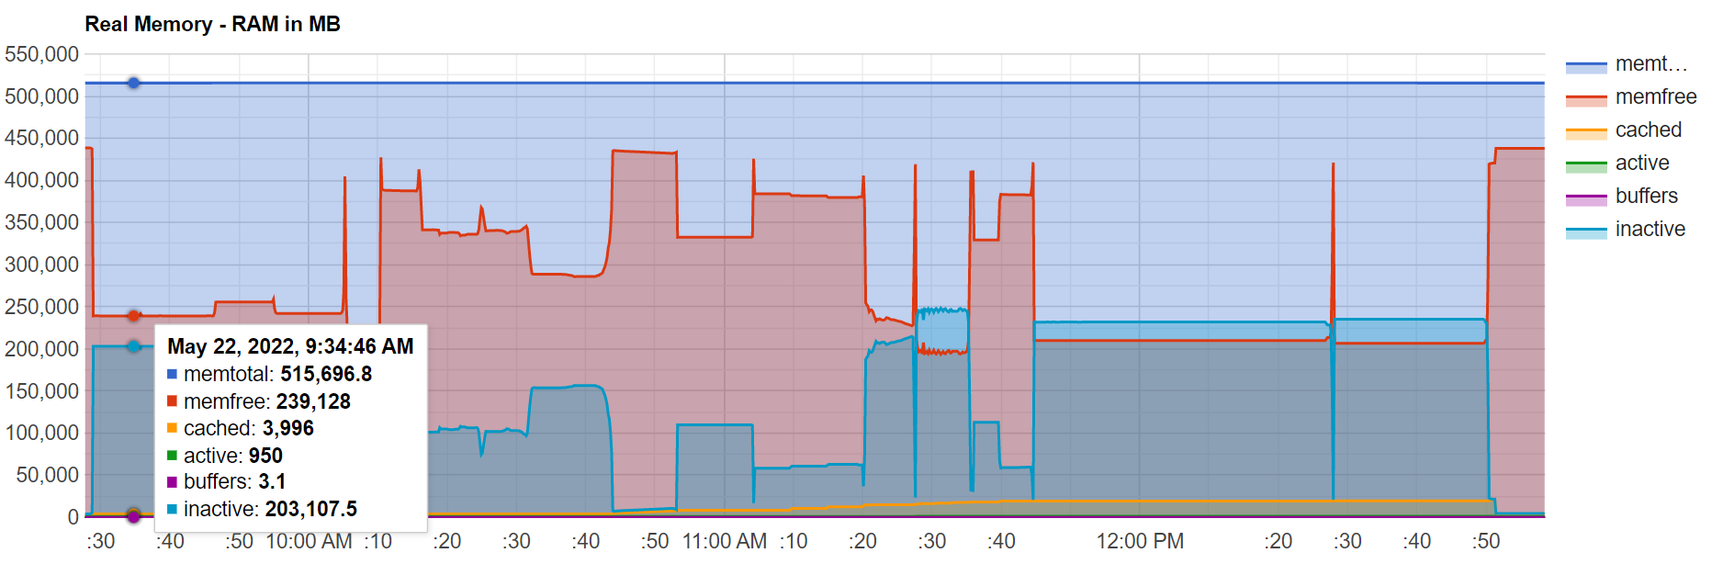
Gen-to-Gen Comparison (ICX vs SPR) fprate
SPR Memory utilization
27
Notes:
Add 1 line of description: 2 GB RAM per Rate copy or process launched

Slide 28
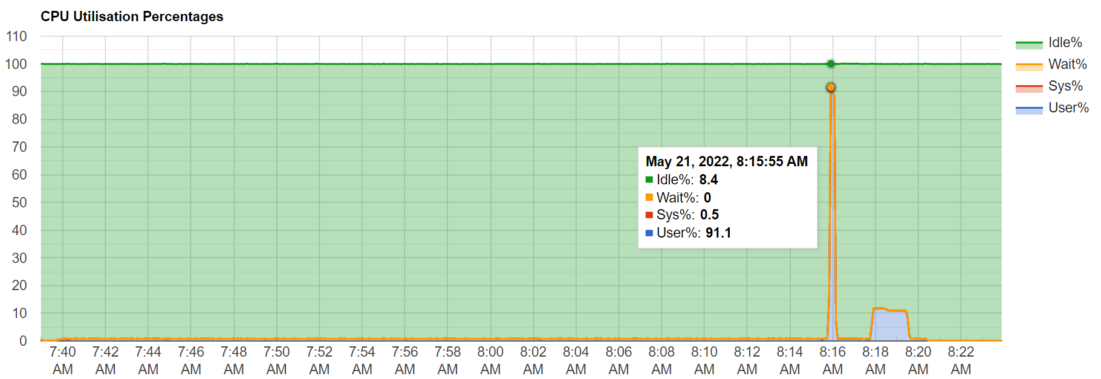
Gen-to-Gen Comparison (ICX vs SPR) intspeed
ICX CPU utilization
28

Slide 29
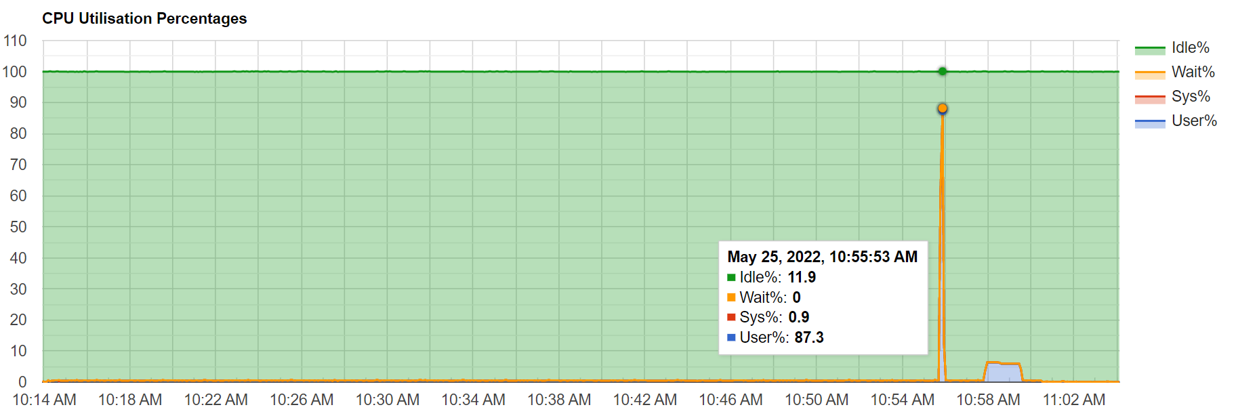
Gen-to-Gen Comparison (ICX vs SPR) intspeed
SPR CPU utilization
29

Slide 30
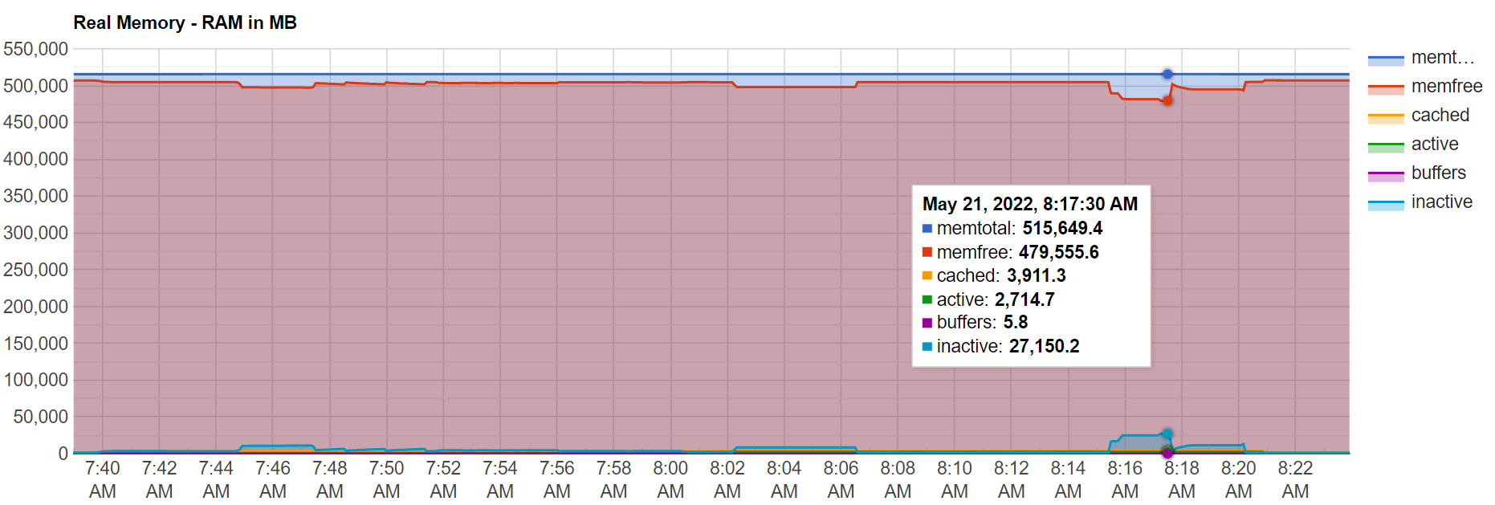
Gen-to-Gen Comparison (ICX vs SPR) intspeed
ICX Memory utilization
30

Slide 31
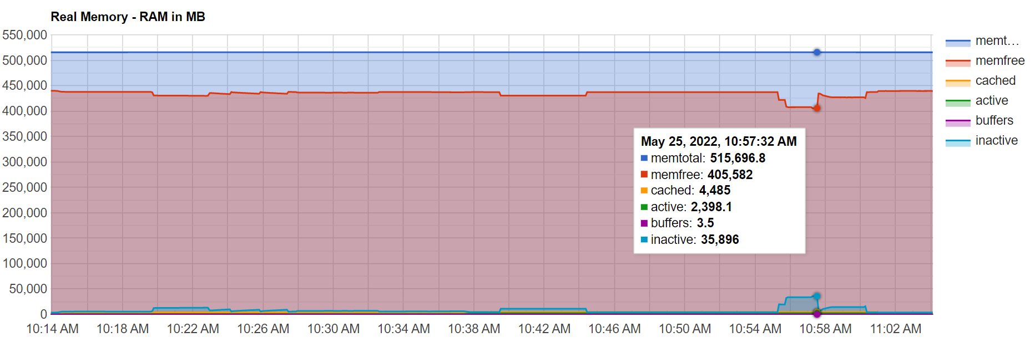
Gen-to-Gen Comparison (ICX vs SPR) intspeed
SPR Memory utilization
31
Notes:
Add 1 line of description: 2 GB RAM per Rate copy or process launched

Slide 32
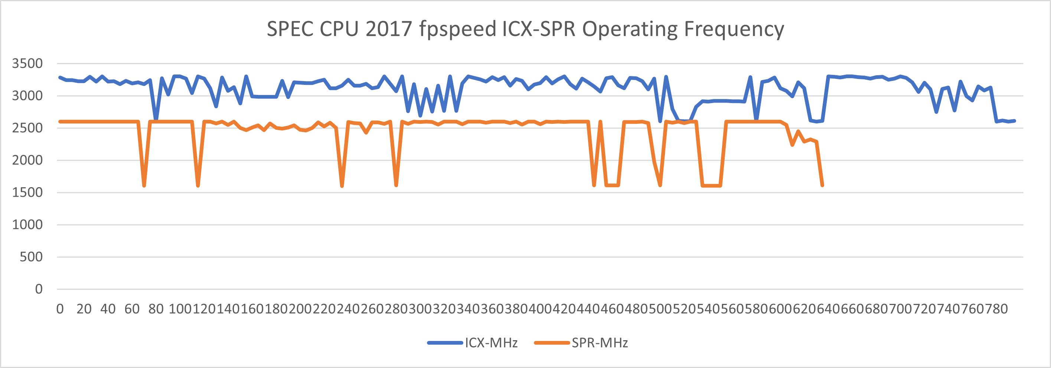
Gen-to-Gen Comparison (ICX vs SPR) fpspeed
32
Notes:
notes: no numa//numa=0 from SF code

Slide 33
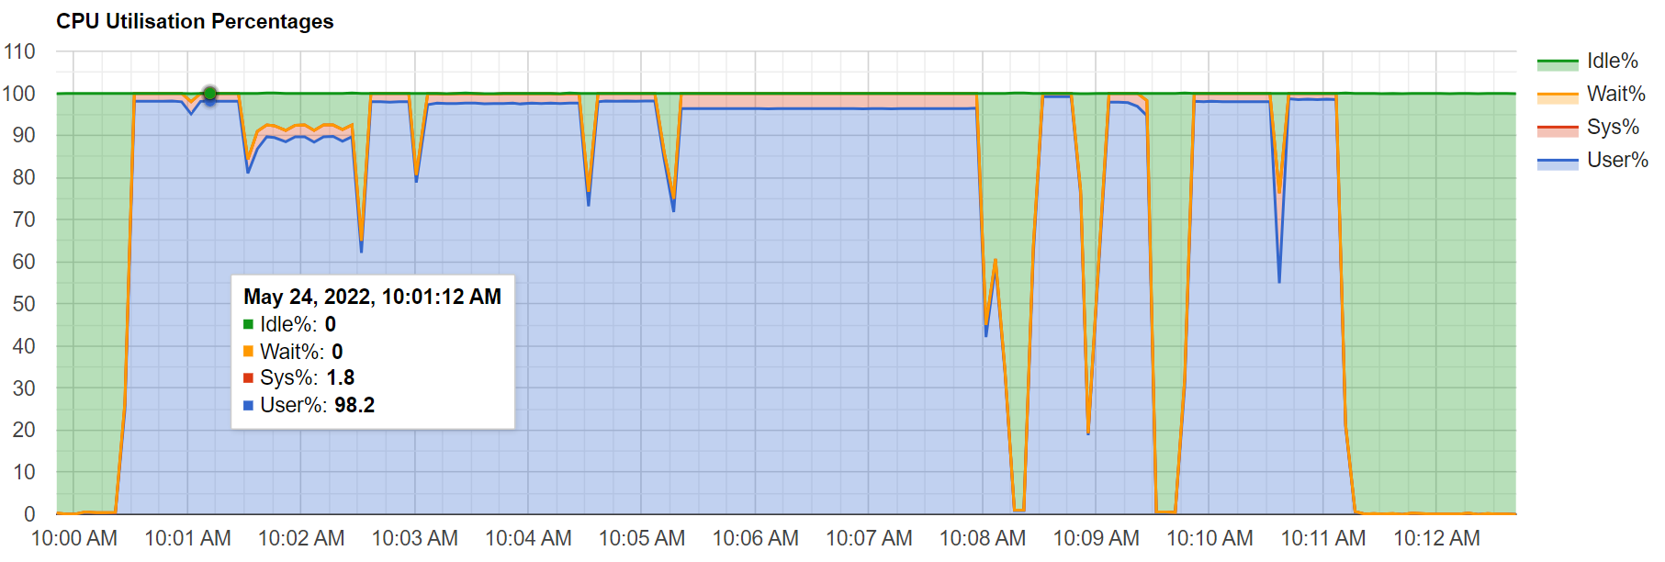
Gen-to-Gen Comparison (ICX vs SPR) fpspeed
SPR CPU utilization
33

Slide 34
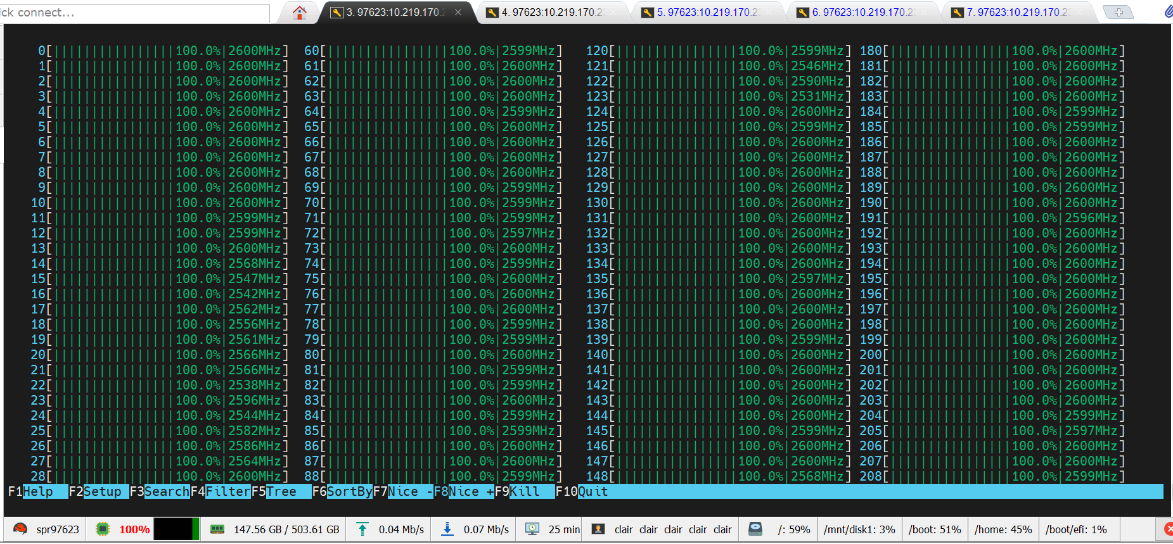
Gen-to-Gen Comparison (ICX vs SPR) fpspeed
SPR CPU utilization
34

